Slide 1

RECURRENT NETWORKS
Introduction
Suppose we want to predict tomorrow’s stock market’s average y(t+1)
Suppose we want the prediction to be based on today’s and yesterday’s economic indicators x_{i}(t) & x_{i}(t-1)
In this case we can have as many input neurons as the number of known elements in the data

Slide 2
RECURRENT NETWORKS
Introduction
However, if we wish the network to consider an arbitrary-sized window of time in the past (e.g. sometimes two days, sometimes 20 days), then a different solution is required
The recurrent networks provide one such solution
They are used to learn sequential or time-varying patterns, in which the current value of the pattern is dependent upon its past history
Elman, 1990

Slide 3
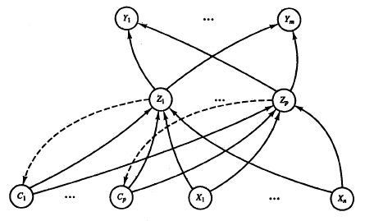
RECURRENT NETWORKS
Architecture
A specific group of units receives feedback signals from the previous time step
These units are known as context units
The weights on the feedback connections to the context units are fixed (e.g. 1)

Slide 4
RECURRENT NETWORKS
Architecture
Context unit is feed-forward connected to its hidden unit & all other hidden unit
Number of context units = number of hidden units
One hidden unit has feedback connection to one context unit only

Slide 5
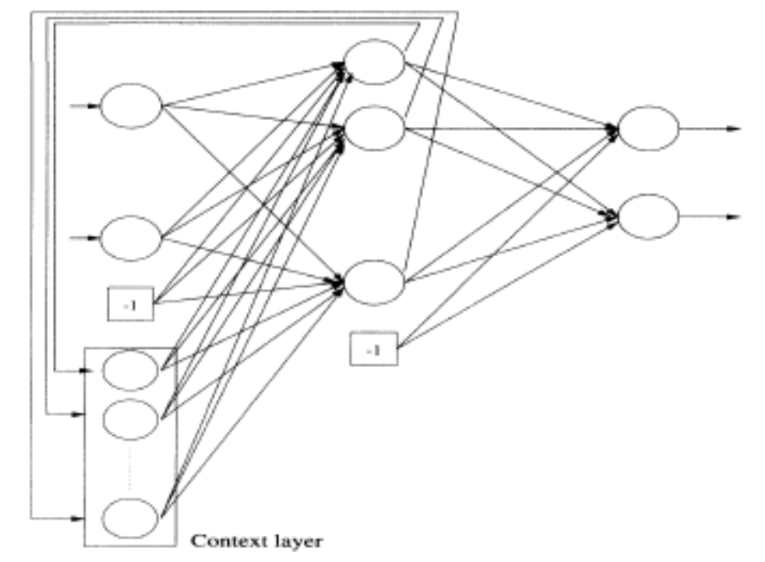
RECURRENT NETWORKS
Architecture

Slide 6
RECURRENT NETWORKS
Training of Weights
At time t, the activations of the context units are the activations (output signals) of the hidden units at the previous time step
The weights from the context units to the hidden units are trained in exactly the same manner as the weights from the input units to the hidden units
Thus, at any time step, the training algorithm is the same as for standard backpropagation

Slide 7
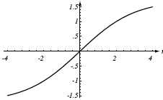
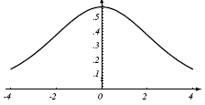

RECURRENT NETWORKS
Utilization
After training for a particular function, the recurrent net can be shown the elements of an arbitrary sized sequence generated from the same function, one by one, and it will predict the next element of the sequence at each step

Slide 8
RECURRENT NETWORKS
Utilization
It can also be trained to classify or label a function. We give an arbitrary sized portion of a sequence as input and the network will try to tell us the name of the function which generated that sequence
It does so by predicting the output when an element of the sequence is shown as input. If the output is the same as the next element of the sequence then the probability of the sequence being from the function for which the recurrent net was trained increases

Slide 9
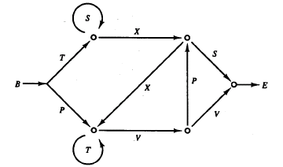
RECURRENT NETWORKS
Example: Next valid letter in a string of characters
Suppose that a string of characters are generated by a small finite-state grammar. The string begins with the symbol B and ends with the symbol E
At each decision point, either path can be taken with equal probability
Two examples of the possible strings are
B P V V E
& B T X X T T V P S E

Slide 10
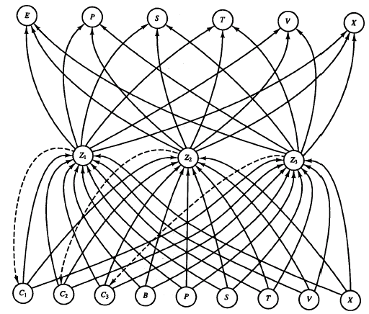
RECURRENT NETWORKS
Example: Architecture used

Slide 11
RECURRENT NETWORKS
Example: Training
The training patterns for the neural net consisted of 60,000 randomly generated strings
The string length ranged from 3 to 30 letters (plus the Begin and End symbols at the beginning and end of strings)
The letters in the string are presented sequentially to the net, one by one, respecting the order in which they appear
Each letter in the string becomes an input, on its turn, and its successor is considered as the output

Slide 12
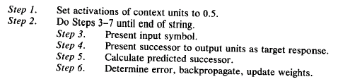
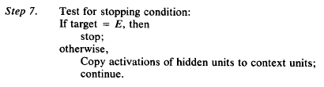
RECURRENT NETWORKS
Example: Training
The training algorithm for the context sensitive grammar is:

Slide 13
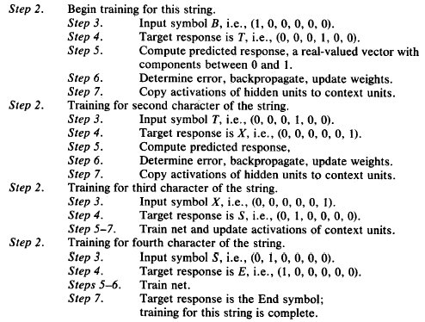
RECURRENT NETWORKS
Example: Training
String
B T X S E

Slide 14
RECURRENT NETWORKS
Example: Testing & Utilization
After training, we hope that the net has learnt the grammar
Given a valid sequence of letters, it can be used to predict the next valid letter in the sequence
An interesting application can be the determination of a given string as a valid string
As each symbol is presented, the net predicts the possible valid successors of that symbol

Slide 15
RECURRENT NETWORKS
Example: Testing & Utilization
If the next letter in the string is not one of the predicted valid successors, the string is rejected. If all the letters pass the test, then the string is accepted as valid
The reported result for 70,000 random strings, 0.3% (210) of which were valid, is that the net correctly reject 99.7% of the invalid strings and accepted 100% of the valid strings
The net also performed perfectly on a set of extremely long strings (100 or more characters in length)

Slide 16
RECURRENT NETWORKS
Example: Testing & Utilization
Note that the grammar is such that we can establish context with the help of two samples
If the context is deeper than more complex network may be required

Slide 17
RECURRENT NETWORKS
Example: Testing & Utilization
The example may be adapted to other problems
For example, letters may be replaced by features composing the letters
or
by words composing a sentence

Slide 18
RECURRENT NETWORKS
Conclusion
The architecture that we have studied is called “simple recurrent network” as it contains a single hidden layer
It is also called Elman network and is similar to an architecture proposed by Jordan (context unit inputs are feedback from output layer, instead of hidden layer)
It is implemented in Matlab’s neural network tool-box

Slide 19
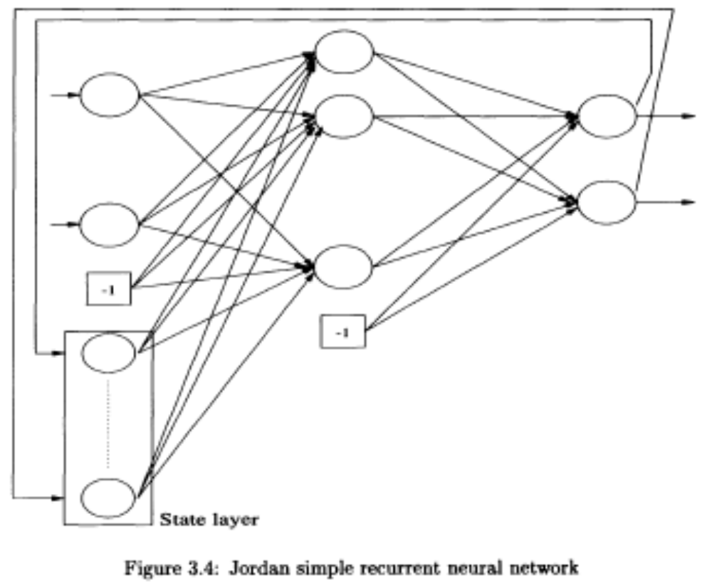
RECURRENT NETWORKS
Conclusion
Jordan’s architecture

Slide 20
RECURRENT NETWORKS
References
Section 3.1.4, Engelbrecht
&
Section 7.2.3, page 372 of Laurene Fausett

